Slide 1
Lecture 1
Fundamentals of C# language

Slide 2
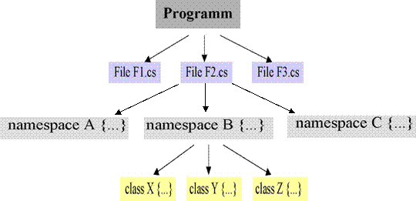
Structure of C# Programs

Slide 3
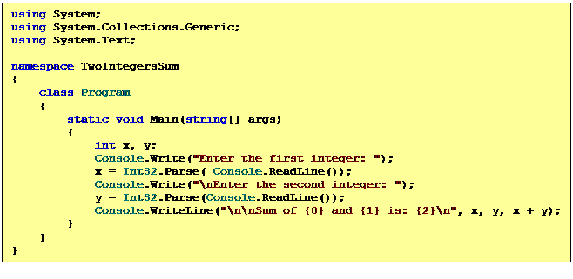
First C# program
Summation of two integers as Console Application
uses the namespace System
entry point must be called Main
output goes to the console
file name and class name need not to be identical.

Slide 4
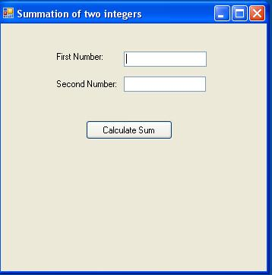
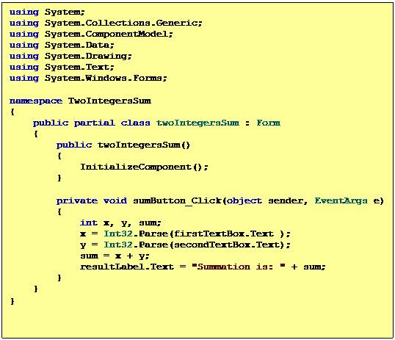
C# windows application
Summation of two integers as a windows application

Slide 5
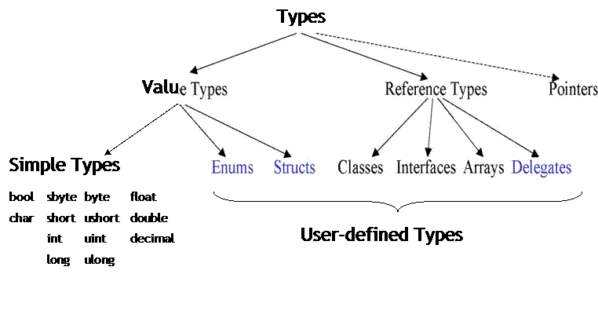
Types
Unified Type System
Value types: simple types (bool, char, byte, short, int, long, uint, ulong, float, double, decimal), Enums, Structs;
Reference types: Classes, Interfaces, Arrays, Delegates
Pointers

Slide 6

Value Types versus Reference Types
 | Value Types | Reference Types
variable contains | value | reference
stored | On stack | heap
initialization | 0, false, '\0' | null
assignment | copies the value | copies the reference
example | int i = 17; | string s = "Hello";
 | int j= i; | string s1= s;

Slide 7
Simple Types
 | Long Form | Range
Sbyte | System.SByte | -128 .. 127
byte | System.Byte | 0 .. 255
short | System.Int16 | -32768 .. 32767
ushort | System.UInt16 | 0 .. 65535
int | System.Int32 | -2147483648 .. 2147483647
uint | System.UInt32 | 0 .. 4294967295
long | System.Int64 | -2⁶³.. 2⁶³-1
ulong | System.UInt64 | 0 .. 2⁶⁴-1
float | System.Single | ±1.5E-45 .. ±3.4E38 (32 Bit)
double | System.Double | ±5E-324 .. ±1.7E308 (64 Bit)
decimal | System.Decimal | ±1E-28 .. ±7.9E28 (128 Bit)
bool | System.Boolean | true, false
char | System.Char | Unicode character

Slide 8
Enumerations
Declaration
enum Color {red, blue, green} // values: 0, 1, 2 enum Access {personal=1, group=2, all=4} enum Access1 : byte {personal=1, group=2, all=4} Color c = Color.blue; // enumeration constants must be qualified Access a = Access.personal | Access.group; if ((Access.personal & a) != 0) Console.WriteLine("access granted");

Slide 9
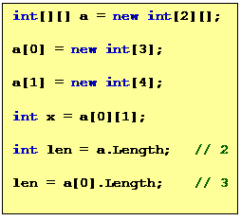
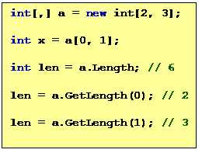
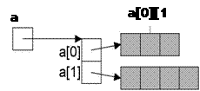
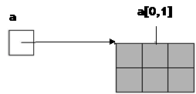
Arrays
int[] a = new int[3];
int[] b = new int[] {3, 4, 5};
int[] c = {3, 4, 5};
SomeClass[] d = new SomeClass[10]; // Array of references
SomeStruct[] e = new SomeStruct[10]; // Array of values (directly in the array)
int len = a.Length; // number of elements in a

Slide 10
Strings
Can be used as standard type string
string s = "Alfonso";
Note
•Strings are immutable (use StringBuilder if you want to modify strings)
•Can be concatenated with +: "Don " + s
•Can be indexed: s[i]
•String length: s.Length
•Strings are reference types => reference semantics in assignments
•but their values can be compared with == and != : if (s == "Alfonso") ...
•Class String defines many useful operations:
CompareTo, IndexOf, StartsWith, Substring, ...

Slide 11
Structs
Declaration
Struct Point {
public int x, y; // fields
public Point (int x, int y) // constructor
{
this.x = x;
this.y = y;
}
public void MoveTo (int a, int b) // methods
{
x = a;
y = b;
}
}
Use
Point p = new Point(3, 4); // constructor initializes object on the stack
p.MoveTo(10, 20); // method call

Slide 12
If statement
if ('0' <= ch && ch <= '9')
val = ch -'0';
else if ('A' <= ch && ch <= 'Z')
val = 10 + ch -'A';
else {
val = 0;
Console.WriteLine ("invalid character {0}", ch);

Slide 13
Switch statement
switch (country) {
case "Germany": case "Austria": case "Switzerland":
language = "German";
break;
case "England": case "USA":
language = "English";
break;
case null:
Console.WriteLine("no country specified");
break;
default :
Console.WriteLine("don't know language of {0}", country);
break;
}

Slide 14
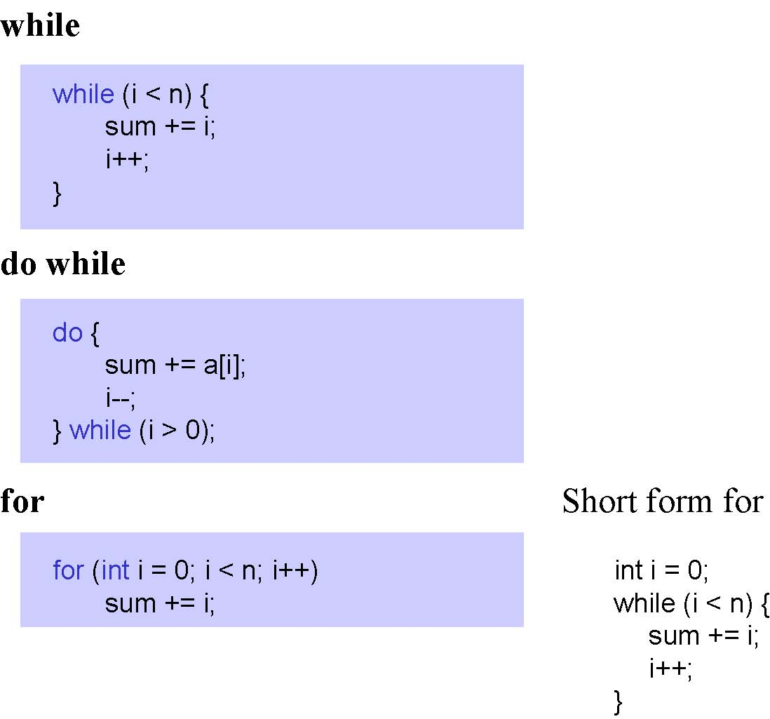
Loops

Slide 15
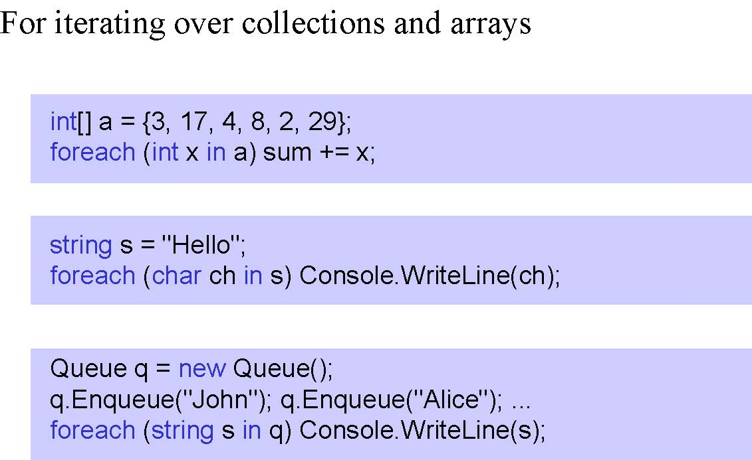
Foreach statement

Slide 16
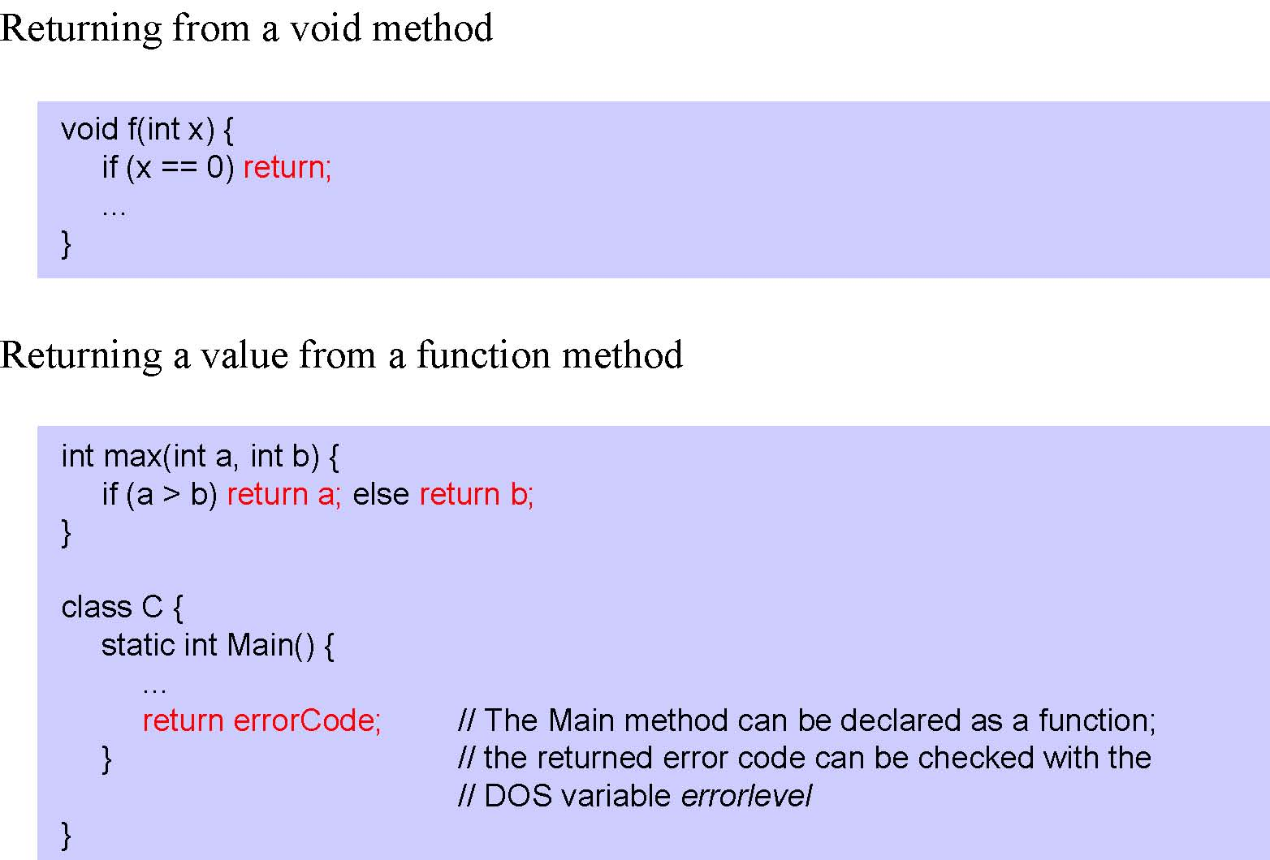
Return statement

